Slide 1
Setup and Installation
Spring Tool Suite (STS)

Slide 2

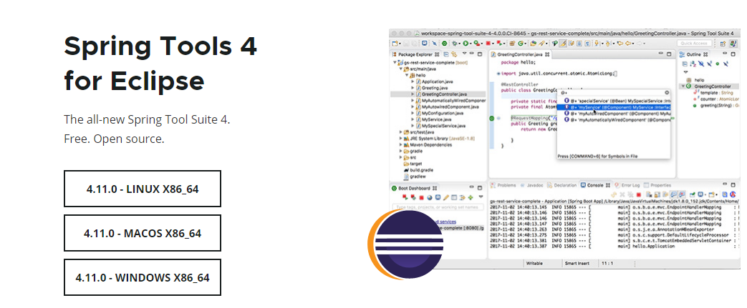
Installing Spring Tool Suite (STS)

Slide 3
Double Click self extracting jar

Slide 4
Can also use java –jar command
The "self-extracting" jar contains a main method, so you should be able to just run that JAR file with the "java -jar " command from the command line or double click on it. When it runs, it will extract the STS installation on its own, so there is no need or reason to extract the JAR file manually.

Slide 5
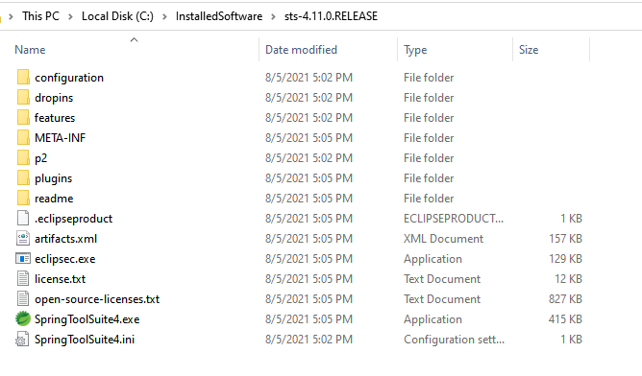
Install directory will be created

Slide 6
Cretae a Desktop shortcut and double click it

Slide 7
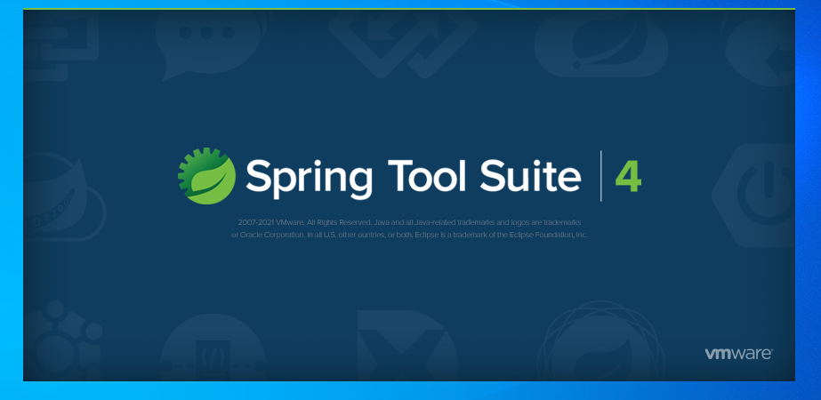
Spring Tool Suite will now launch

Slide 8
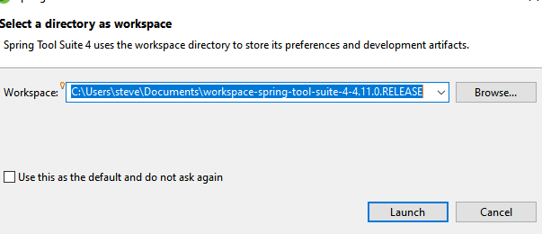
Select a workspace dialog

Slide 9
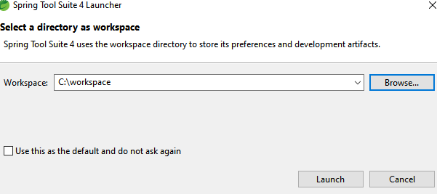
Select a workspace

Slide 10
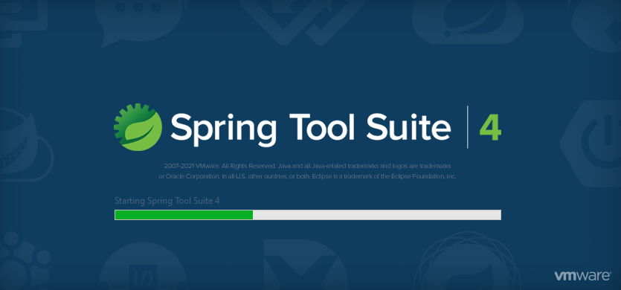
STS will open to the selected workspace

Slide 11
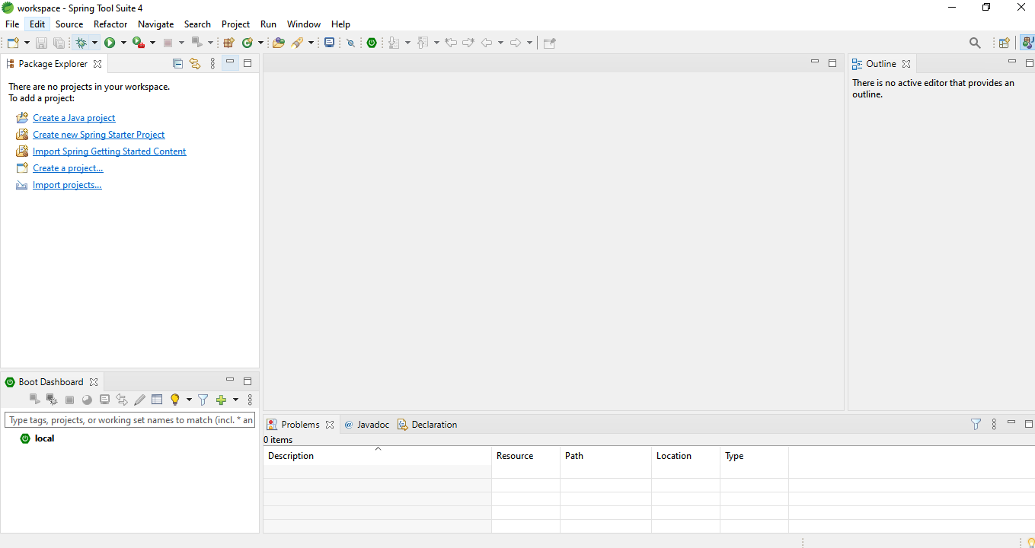
Spring Tool Suite workspace!!

Slide 12
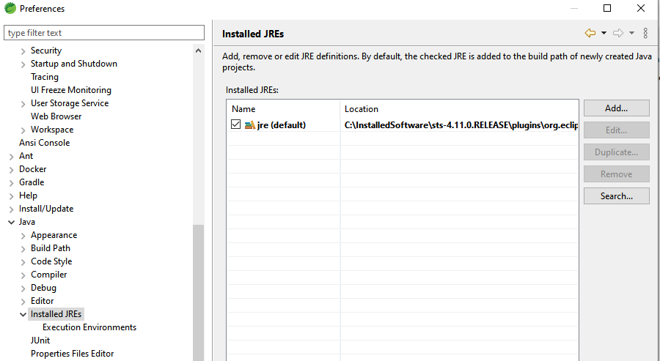
Customize “Installed JREs”

Slide 13
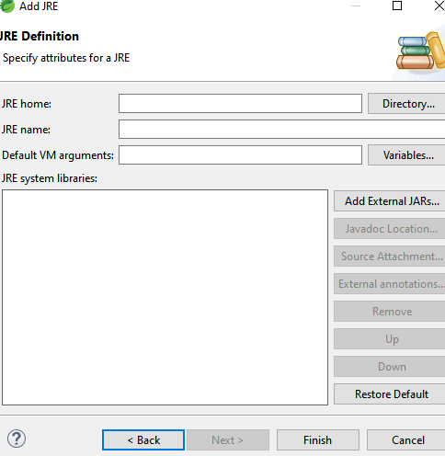
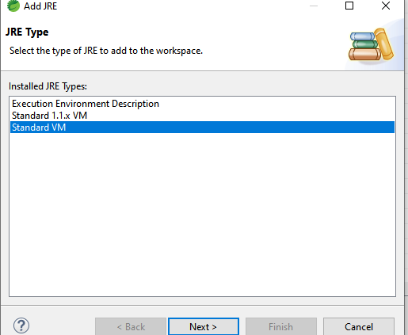
Set to location of root JDK installation directory

Slide 14
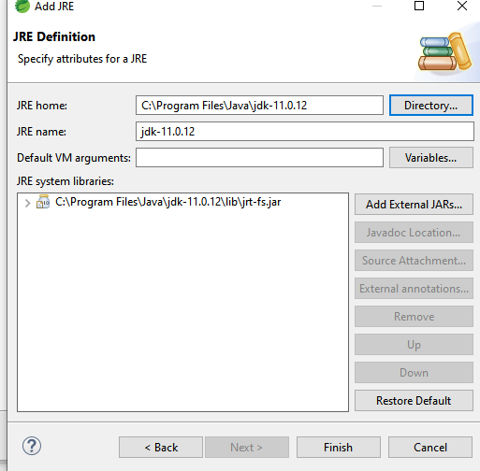
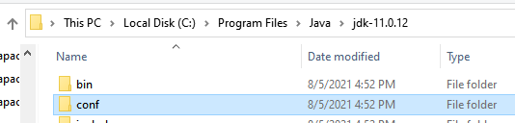
Set to location of root JDK installation directory

Slide 15
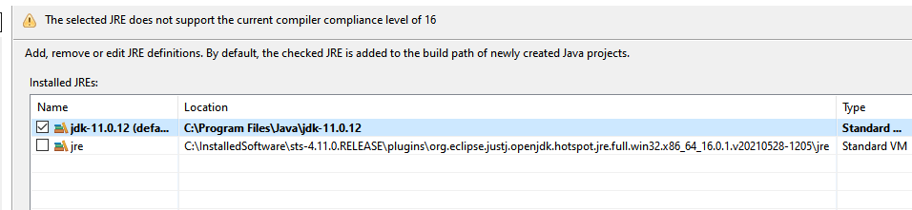
Set as Default

Slide 16
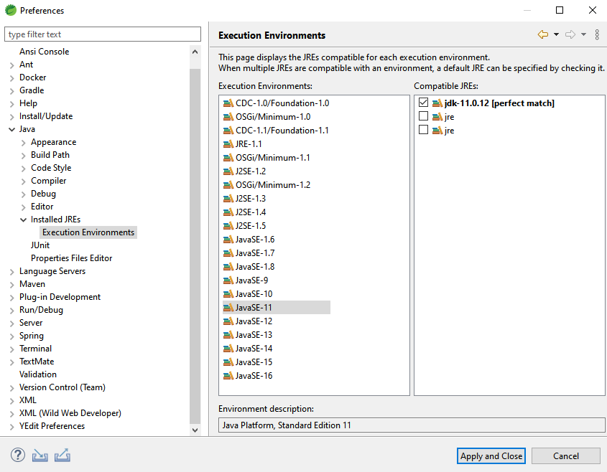
Change Execution Environment

Slide 17
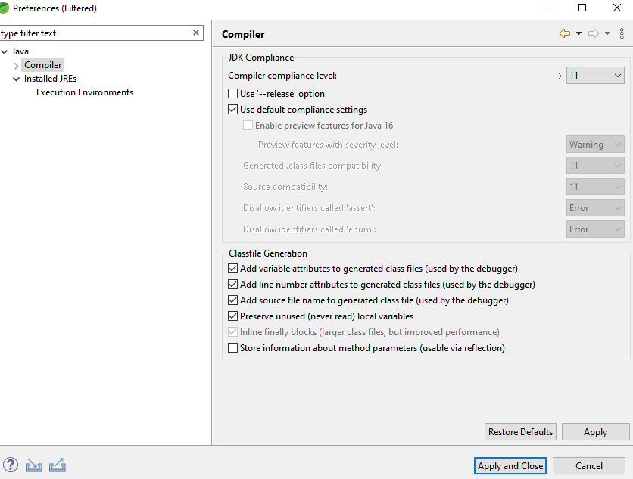
Change compliance level

Slide 18
Tips to increase STS performance

Slide 19
Window ==> Preferences

Slide 20
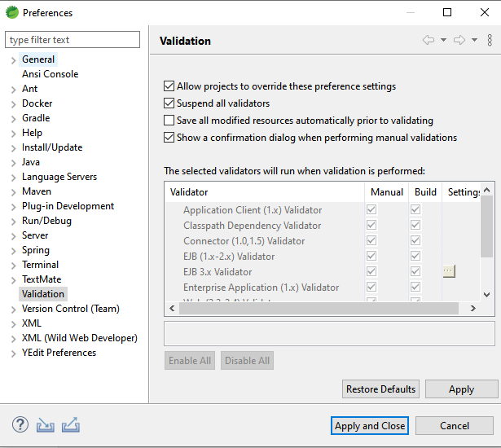
Suspend All Validators

Slide 21
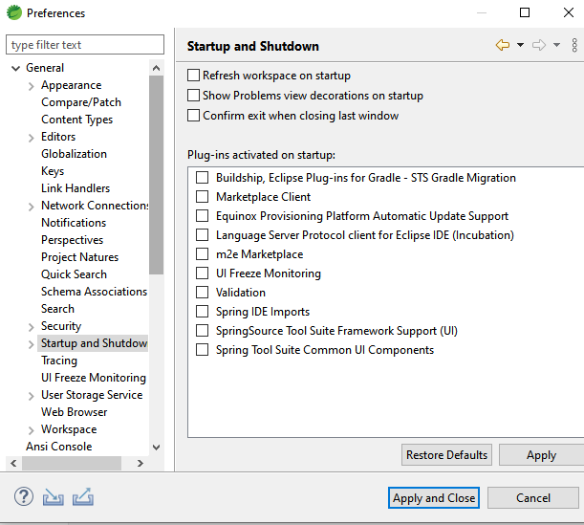
Disable Plug-ins activated on startup

